Slide 1
The Effects of Armed Conflict on Educational Attainment and Inequality
Carina Omoeva
Wael Moussa
Rachel Hatch
FHI 360 Education Policy and Data Center
UNCEF
New York, NY
May 10, 2016
Notes:
Carina

Slide 2
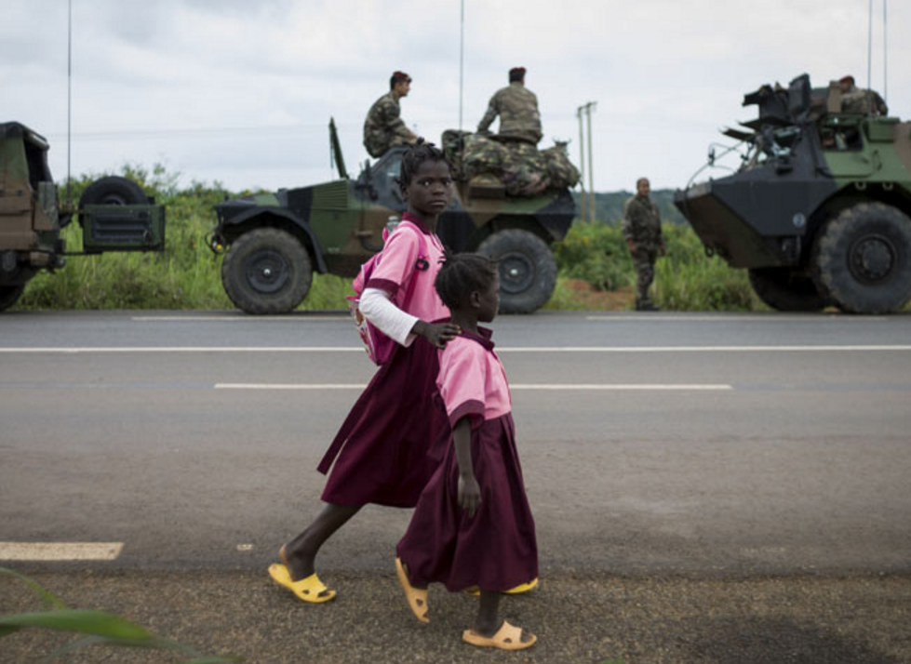
Côte d'Ivoire, 2004
Photo credit: Getty Images
Notes:
Conflict affects both the supply and demand of education, it affects WHAT gets taught, and the aftermath of conflict, particularly prolonged conflict, often involves complete overhaul of curricula and a ground-up reconstruction of teacher training and deployment systems and school infrastructure and supplies.
The question is, does conflict affect everyone in the same way, or does it affect some people or some groups to a larger extent than the others. And that is important to be very certain about, because we have been able to show that education inequality is itself a strong predictor of future conflict.
So – this relationship between conflict as a phenomenon and its effects on education inequality is the subject of our study.

Slide 3
Research Questions
Does the violent conflict affect education?
Attainment? theoretical impact unambiguously negative
Inequality? theoretical impact ambiguous
Does the nature of the conflict matter?
Does the duration of the conflict matter?
Do countries’ level of fragility matter?

Slide 4
Conflict → Education Inequality?
Exacerbates
There are winners and losers in every conflict
The losers will see a worsening of their education outcomes, leading to greater inequality
After conflict
Notes:
We set up our hypothesis the following way. We argue that conflict exacerbates inequality because there are winners and losers in every conflict, and that the losers, consequently, will see a worsening of their education outcomes. This means that education outcomes will become more unequal.

Slide 5
Conflict → Education Inequality?
Resolves
Many conflicts are fought in large part because of education inequality
If the disadvantaged side wins, education opportunity becomes more equitable
After conflict
Notes:
However, we could also see how it could in fact help resolve inequality. The truth is that many conflicts are fought in large part because of education inequality. It played a big role in South Africa, in the civil rights movement here in the U.S., in Sri Lanka, other examples. We found in our analysis that it’s true on average. In such cases, measures were taken to address issues of unfair and unequal access to education. So, which one is it?

Slide 6
Conflict → Education Inequality?
Resolves
Exacerbates
Many conflicts are fought in large part because of education inequality
If the disadvantaged side wins, education opportunity becomes more equitable
There are winners and losers in every conflict
The losers will see a worsening of their education outcomes, leading to greater inequality
Notes:
So, which one is it?

Slide 7
Resolving inequality
Evidence is primarily based on a few known cases
Rwanda: after genocide, education levels declined more for the non-poor and for boys (Akresh & De Walque, 2008)
Nepal: educated and better-resourced individuals choose to leave the country during conflict OR where targeting inequality is a part of the rebel agenda (Valente, 2011)
Notes:
What does the literature say? The literature for the positive effects of conflict is predictably sparse.

Slide 8
Exacerbating inequality
Poorer families are less able to afford school during periods of conflict (UNESCO, 2011)
When fighting is geographically concentrated, regional inequality rises
e.g., Turkey (Kibris, 2015), Tajikistan (Shemyakina, 2011), and Rwanda (Agüero & Majid, 2014)
School-going more risky for girls due to sexual assault or for boys due to forcible recruitment of child soldiers (Justino, 2010), widening gender differences
Ethnic or religious inequalities may rise where certain groups are targeted during conflict, making school participation more dangerous (Østby & Urdal, 2014), or where service delivery to indigenous groups suffers
e.g., Guatemala (Chamarbagwala and Morán, 2011)
Notes:
However, the literature on the effects of conflict on inequality is sparse in general.

Slide 9
A Vicious Cycle?
Education Inequality
Violent Conflict
Literature is very sparse, generally formed by case studies
Quantitative analyses are correlational
Notes:
What we need to know, or be able to unpack is this vicious cycle

Slide 10
Findings
Ethnic conflict exacerbates inequality
Particularly true for wealth inequality, gender parity
“Minor” conflicts have more prominent effects on inequality
Inequality worsens in protracted conflict
Effects of conflict are more detrimental for high fragility countries
Post-conflict, inequality does not return to pre-conflict levels

Slide 11
Our Measures

Slide 12
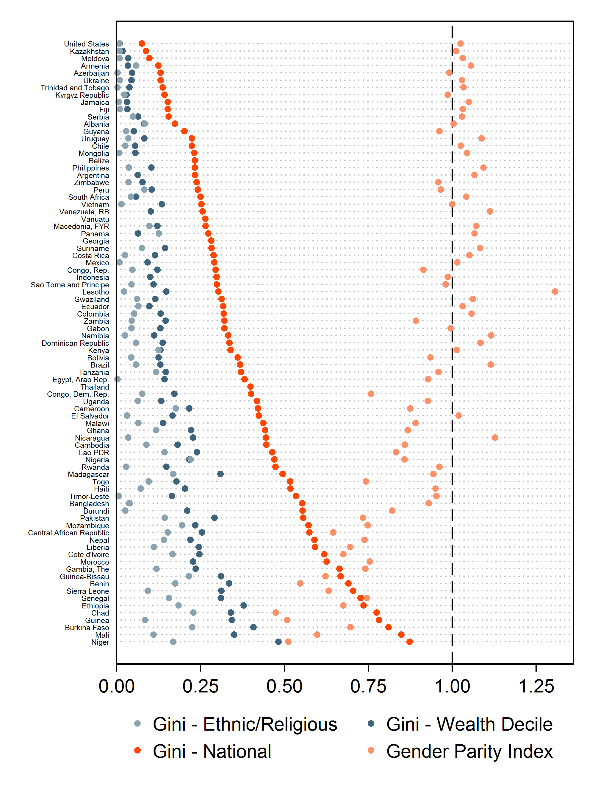
Defining Education Inequality
Disparity in years of schooling completed, across groups or individuals
Vertical: across individuals
Horizontal: between-groups; ethnic/religious, gender, wealth
Measured using the Gini coefficient (can be Theil, simple difference in means, standard deviation)
Notes:
Education inequality – limited by data availability of course we are not able to look at what’s perhaps most important. Resource allocation and learning outcomes.

Slide 13
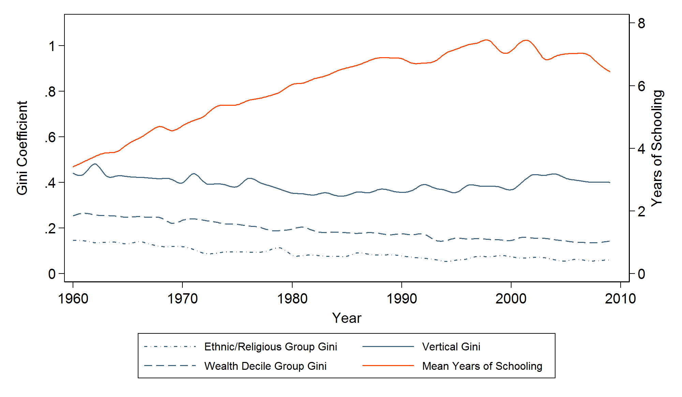
Trends in Education and Education Inequality

Slide 14
Defining Armed Conflict
A contested incompatibility that concerns government and/or territory where the use of armed force between two parties, of which at least one is the government of a state, results in at least 25 battle-related deaths in a calendar year (UCDP, 2015).
Conflict incidence vs onset
Intensity: Low (25-1,000 deaths/ year) vs High
Duration: Years in conflict post-onset
Type: intrastate, interstate, non-state
Nature: ethnic, “popular rebellion”, terrorism
Notes:
Now, let’s stop to define what specifically we mean by conflict. This is a definition from the Uppsala Conflict Data Program

Slide 15
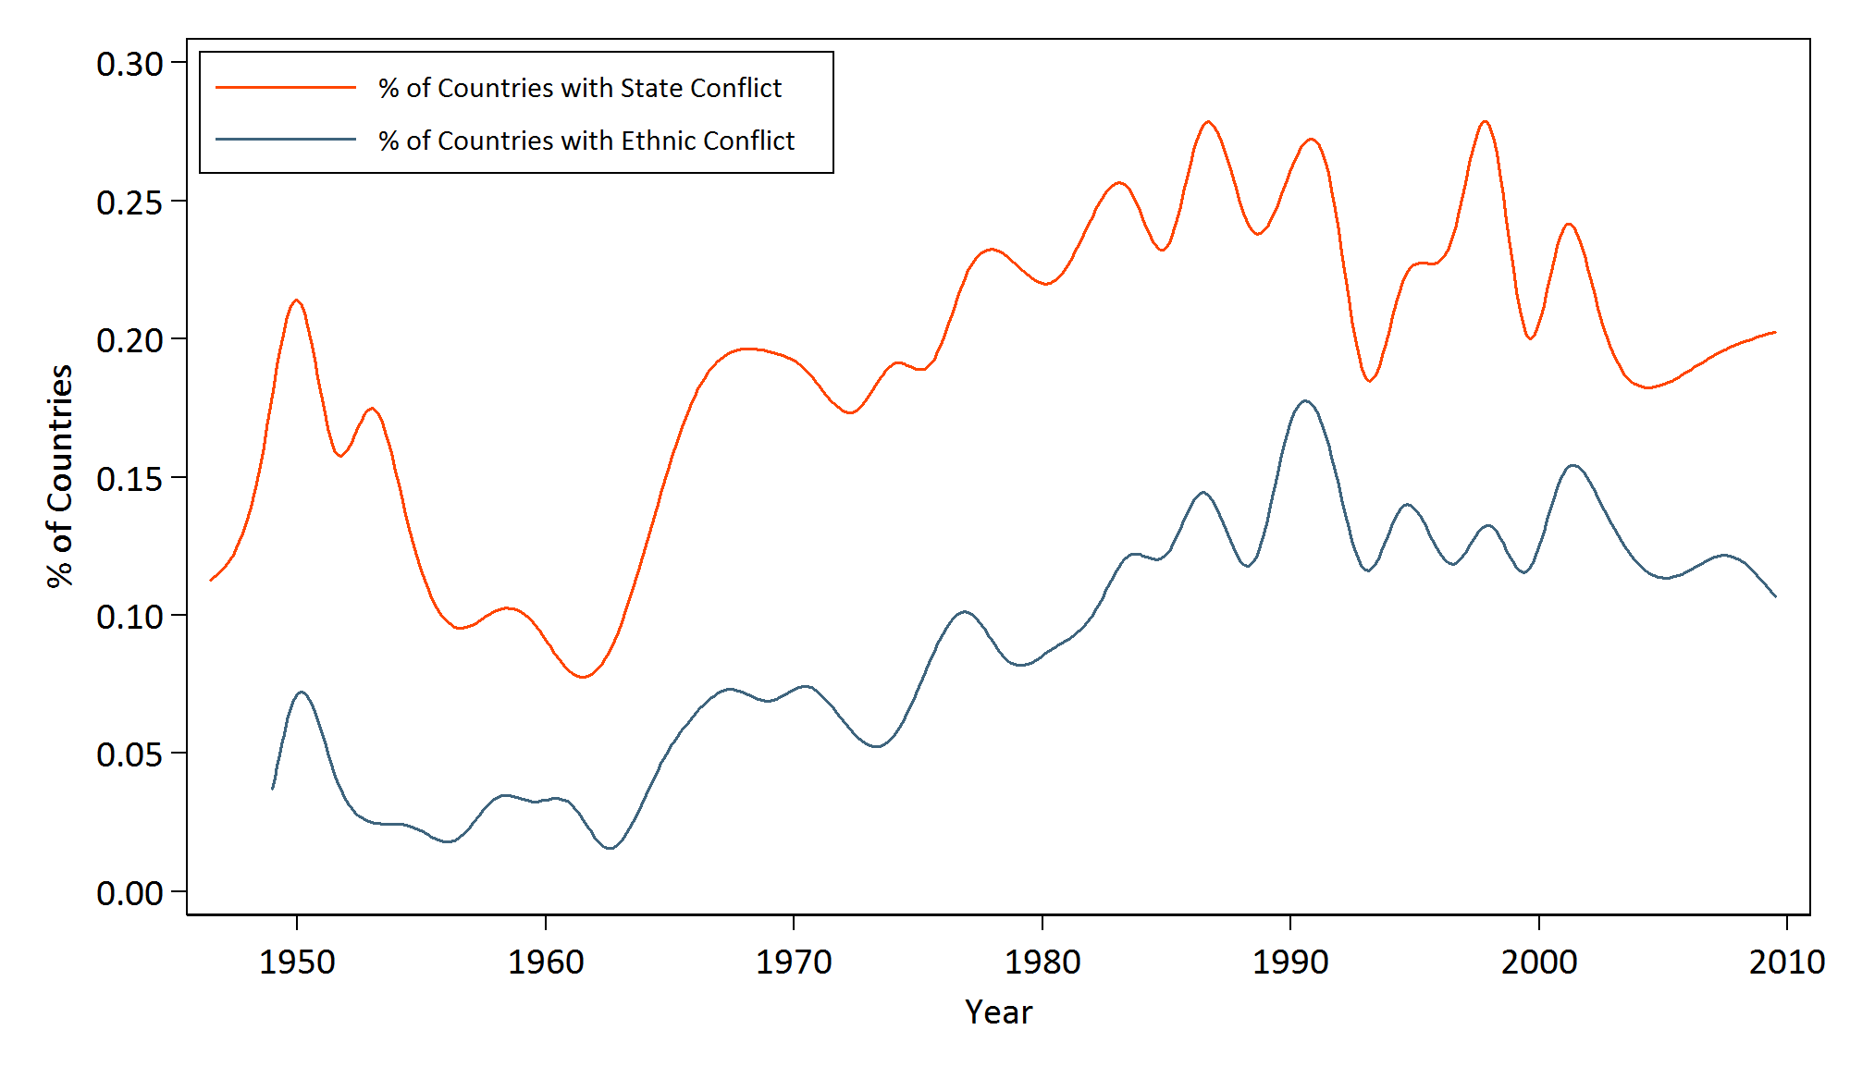
Trends in Armed Conflict

Slide 16
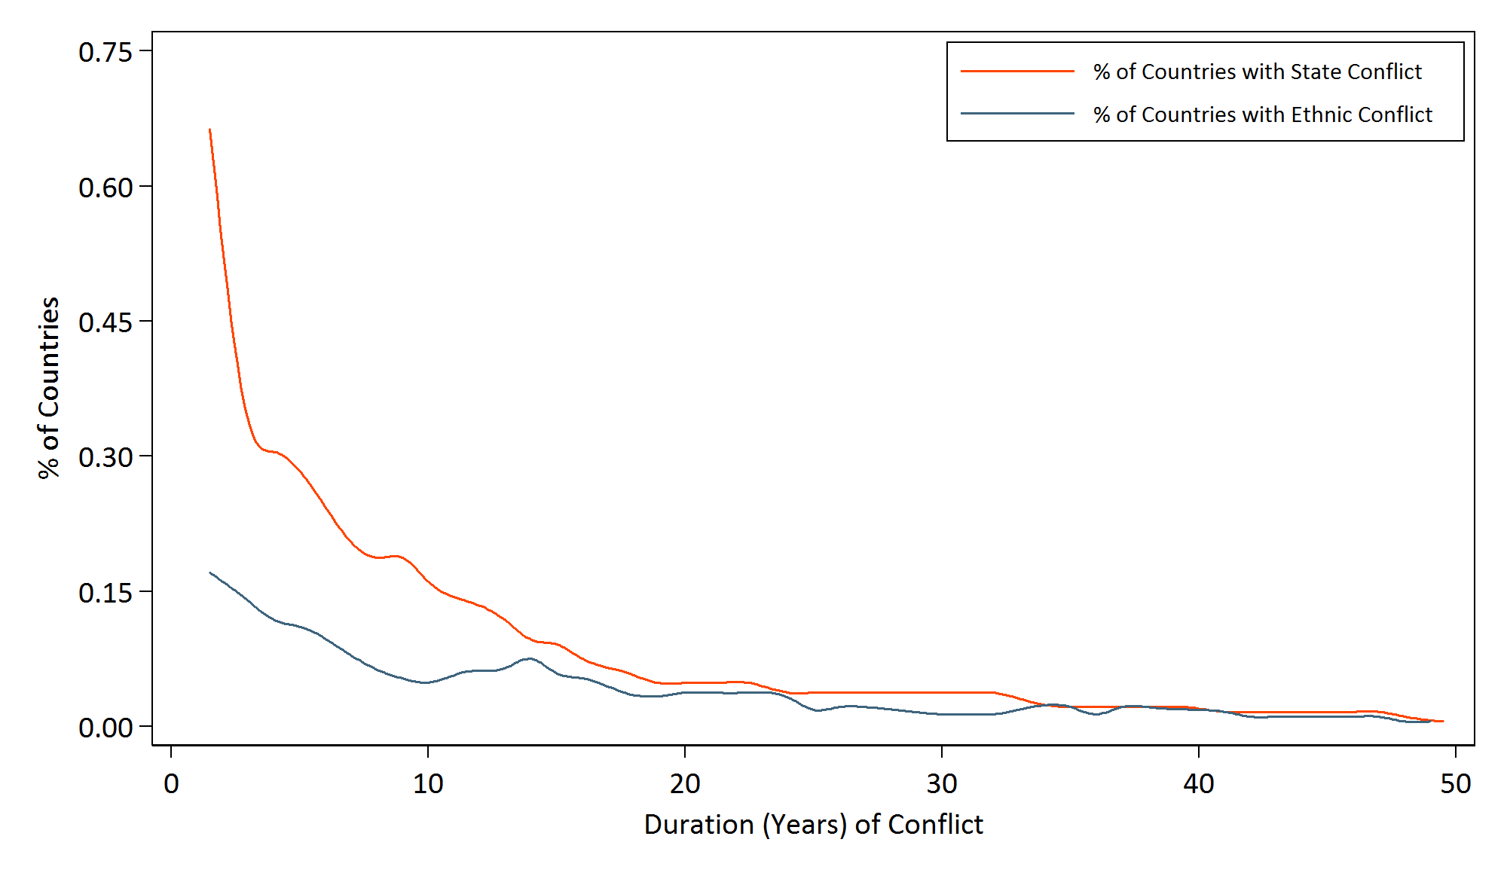
Duration of Armed Conflict

Slide 17
Data & Methodology

Slide 18
Education Inequality and Conflict Dataset (FHI 360 Education Policy and Data Center 2015)
Global scope for education and conflict (100+ countries)
Conflict data on incidence and onset (UCDP, 2015)
1960-2010 data on years of schooling
Inequality in education: mean years of schooling Gini
Individual (vertical)
Ethnic/religious
Wealth (deciles)
Gender
Notes:
Our study takes a global scope
We have done an extensive literature review and established gaps in what is known
Built a 50-year time series – the longest ever, with ethnic, religious, and subnationally disaggregated data
Ran multiple models with several measures of inequality
Controlled for known risk factors

Slide 19
Challenges to identification of conflict effect
Conflict is NOT a random phenomenon
Conflicts are rare, yet most countries have experienced some form of conflict since the end of WWII
Inequality is itself a predictor of conflict

Slide 20
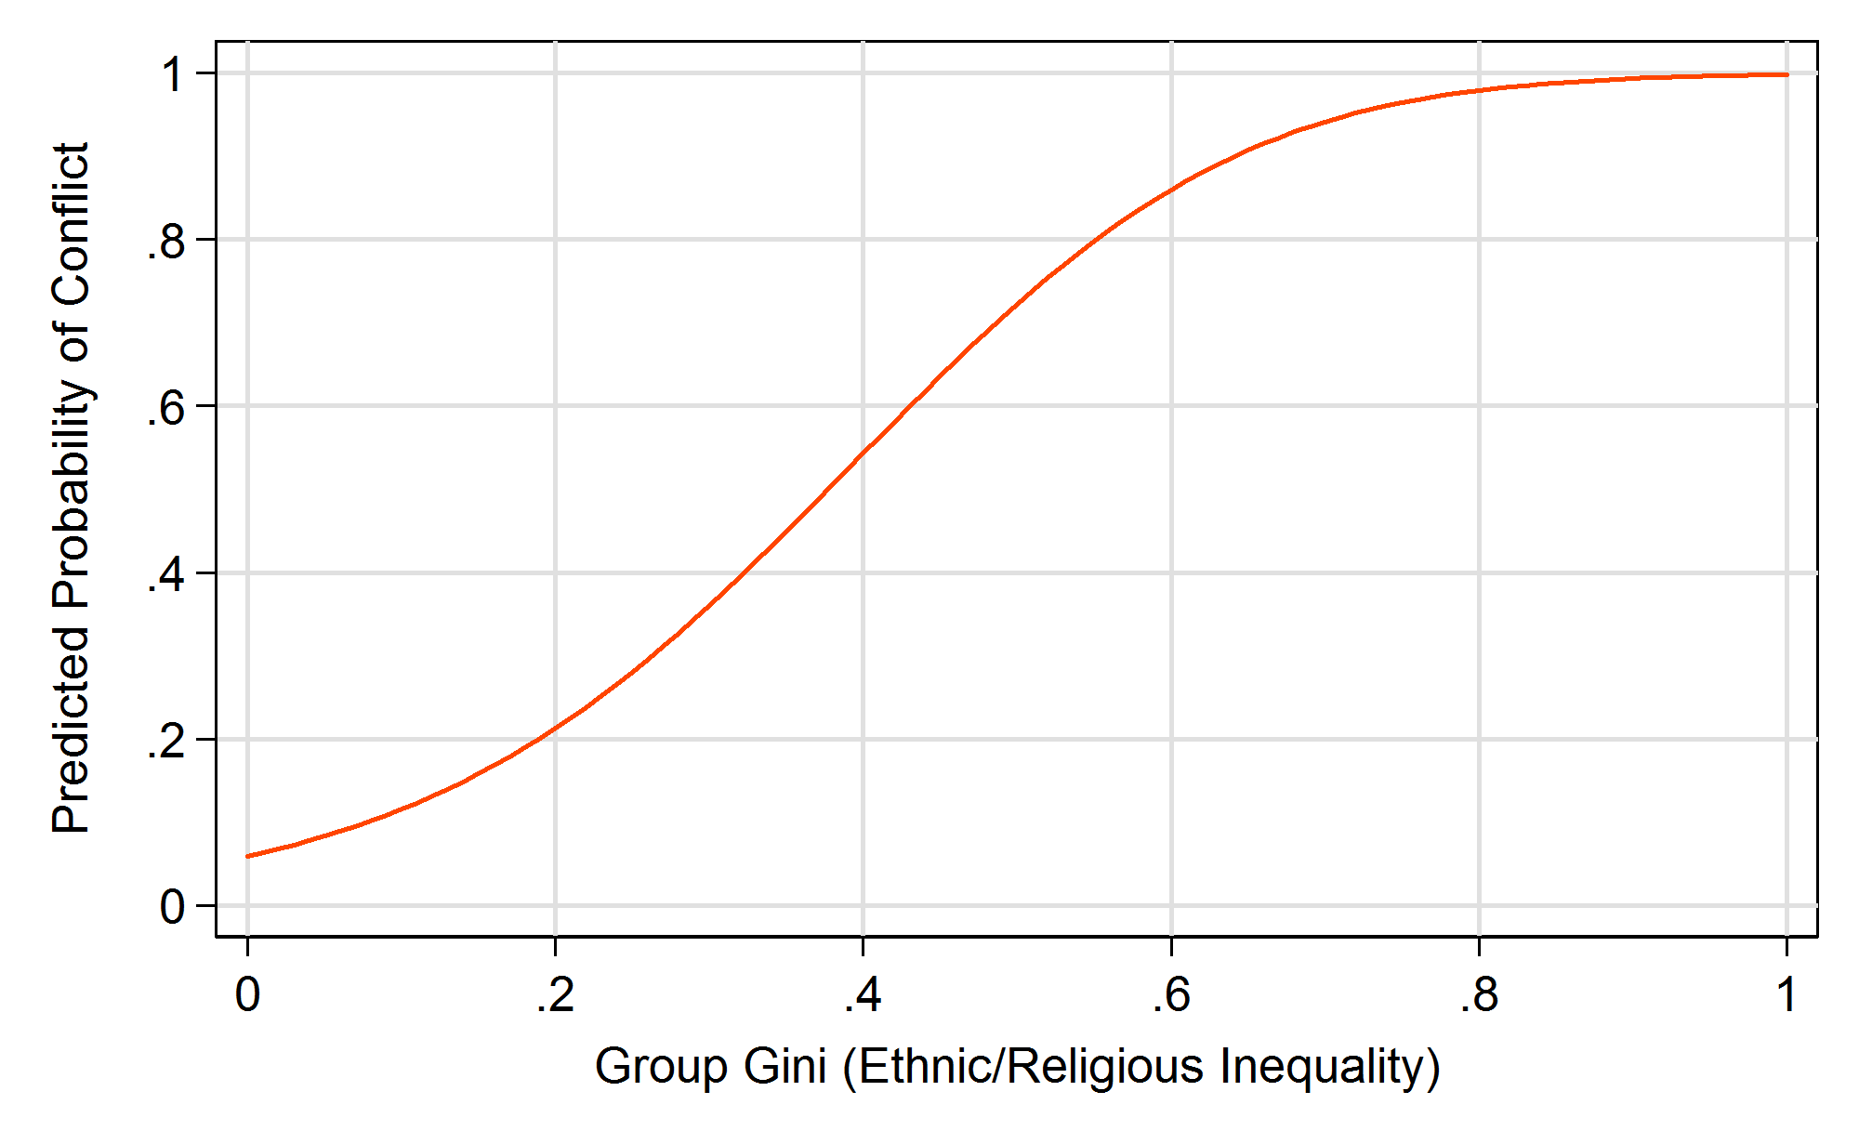
Inequality is itself a predictor of conflict
Notes:
From our previous study

Slide 21
Identification Strategy
Dependent on our ability to isolate the effect of conflict from the effect of fragility
Fragility is the set of conditions that affect both conflict likelihood and the level of education inequality
High Fragility
Conflict
Education Inequality
Notes:
WAEL starts here

Slide 22
Identification Strategy
The timing of the incidence of conflict varies between countries
We exploit this variation to implement a difference-in-differences (DD) strategy to identify the effect of conflict on education attainment and inequality
We compare changes in inequality pre-post conflict onset between treatment and control country-years
Treatment group = Country-year observations in conflict
Control group = Country-year observations without conflict
Notes:
Never experience conflict cannot be the control: what is the pre- and post- condition for these countries

Slide 23
Identification Strategy
Difference-in-Differences Regression Equation:
$$y_{ct}=γ_{c}+λ_{t}+φf\left(p_{t}\right)+δC_{ct}+Xβ+ε_{ct}$$
$y_{ct}$= Mean years of schooling, national Gini, GPI, between-ethnic/religious group Gini, between-wealth group Gini
$γ_{c}$ and $λ_{t}$ represent country and year fixed effects
$f\left(p_{t}\right)$= quadratic function of peace years (5-year lag)
$X$ matrix of control variables (demographic, political, and economic)
$C_{ct}$ = Conflict Incidence

Slide 24
Identification Strategy
Difference-in-Differences Assumptions:
Pre-treatment trends must be parallel
Non-random selection into the treatment group: conflict is not random
Common trends can be tested empirically
Inclusion/exclusion of country-specific time trends in DD regression
Falsification/placebo test (use pre-treatment data and assign false conflict dates)
To circumvent selection bias, we employ propensity score matching (Rosenbaum & Rubin; Heckman, Ichimura, Todd, 1998)
Notes:
I’ll hide this since we already cover this in the other slides.

Slide 25
Identification Strategy
Constructing comparison groups from available country-year observations: propensity score estimation using pre-onset characteristics
Pre-Conflict
Incidence
Treatment Effect
Treatment
Fragility
No Conflict
Conflict
Change in
Education Inequality
Match
No Conflict
No Conflict
Change in
Education Inequality
Control
Fragility
Notes:
Our approach to the identification problem is propensity score matching. Essentially, we are reconstructing the comparison groups using a function of pre-conflict conditions, including inequality, that predict the risk of conflict. In the framework that I showed earlier, this is what it looks like.
1. We are trying to isolate and remove the direct correlation of pre-conflict conditions on inequality (bottom line goes away)
2. So that the only difference between our sets of observations is the fact that they either experienced or did not experience conflict.
In this scheme here, we reconstruct groups with equivalent levels of fragility (conflict likelihood), and then by comparing the post-conflict inequality, we are able to attribute the difference to the actual conflict occurrence.
Very important: we are only able to control for what we observe. There can be any number of factors that affect both likelihood of conflict and the post-conflict observed inequality, that we are not measuring and hence, are unable to account for.

Slide 26
Propensity score matching*
A quasi-experimental design strategy intended to minimize selection bias:
First, a propensity score model is estimated for treatment selection – in this case, conflict
The goal is to account for factors that affect both the likelihood of treatment (conflict) and the outcome (inequality)
For each treated observation, we find a matched control observation that is most similar on key covariates
Once the sample observations (in this case, country-years) are balanced on key covariates, estimate the treatment effect similarly to a randomized experiment, conditional on the propensity score
* For origins see: Rosenbaum, P. & Rubin, D. (1983) The central role of the propensity score in observational studies for causal effects. Biometrika 70(1), pp. 41-55.
Notes:
CARINA: Summarize the methodology for the propensity score estimation. Need to correct for PS weighting.

Slide 27
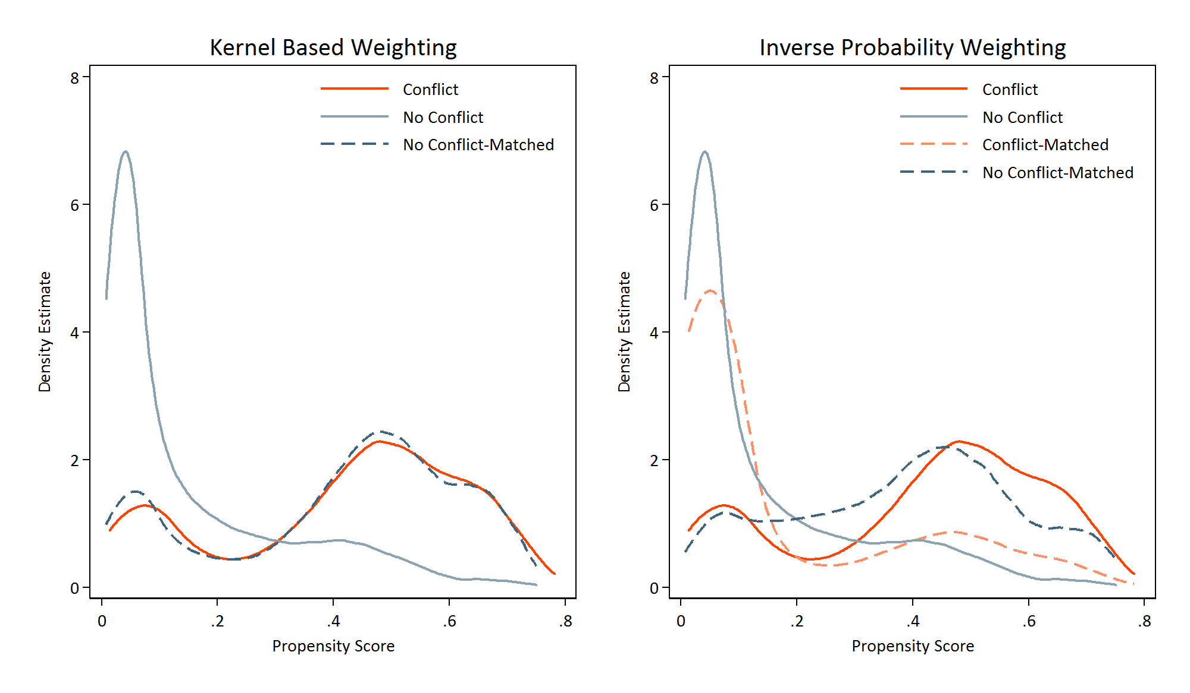
Before and After Matching

Slide 28
Have we constructed equivalent groups?
 | Unmatched |  |  |  | Matched
 | Conflict | No Conflict | Difference |  | Conflict | No Conflict | Difference
Gini - ethnic/rel. groups | 0.127 | 0.108 | 0.019* |  | 0.111 | 0.099 | 0.012*
Gini - wealth decile groups | 0.240 | 0.223 | 0.017* |  | 0.214 | 0.207 | 0.007
Gini - national | 0.454 | 0.420 | 0.034* |  | 0.398 | 0.422 | -0.024
ln(Oil production per capita) | 2.136 | 2.263 | -0.127 |  | 3.497 | 3.099 | 0.397
ln(Real GDP per capita) | 7.545 | 7.712 | -0.167* |  | 8.132 | 8.115 | 0.017
ln(Total population) | 9.615 | 8.662 | 0.953* |  | 10.184 | 10.309 | -0.125
Pct. age 15-24 years | 0.190 | 0.188 | 0.002* |  | 0.194 | 0.194 | 0.001
Democracy | 0.270 | 0.280 | -0.010 |  | 0.512 | 0.461 | 0.052
Anocracy | 0.348 | 0.299 | 0.048* |  | 0.294 | 0.318 | -0.025
Observations | 584 | 2,282 | 2,866 |  | 579 | 2,282 | 2,861
Notes:
Is this observations or countries
Is the comparison specified with the correct weights
Is the balance done on the vertical gini only
Maybe the PSM model should include country and year fixed effects

Slide 29
Findings
Notes:
WAEL

Slide 30
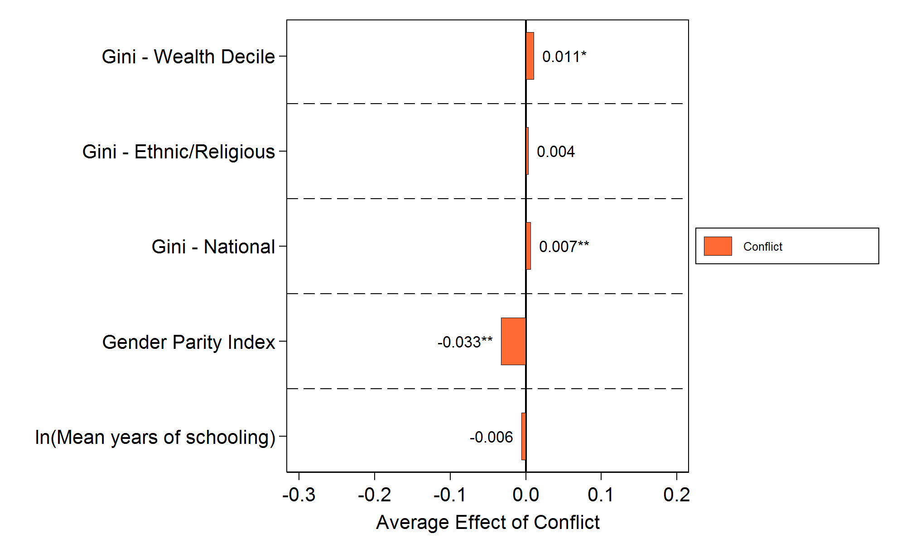
Conflict exacerbates inequality
Notes:
Across several measures of educational outcomes, ethnic conflicts have a larger impact than state (non-ethnic) conflicts. Ethnic conflicts lower mean years of schooling by 8.2 percent, while state conflicts lower mean attainment by 3.3 percent. In a similar pattern, ethnic conflicts increase wealth decile group education Gini, ethnic/religious group education Gini, and vertical education Gini by 3 points, 1 point, and 1.2 points, respectively, while state conflicts increase these educational inequalities by 1 point, 0.2 points, and 0.2 points, respectively.
These are average treatment effects.

Slide 31
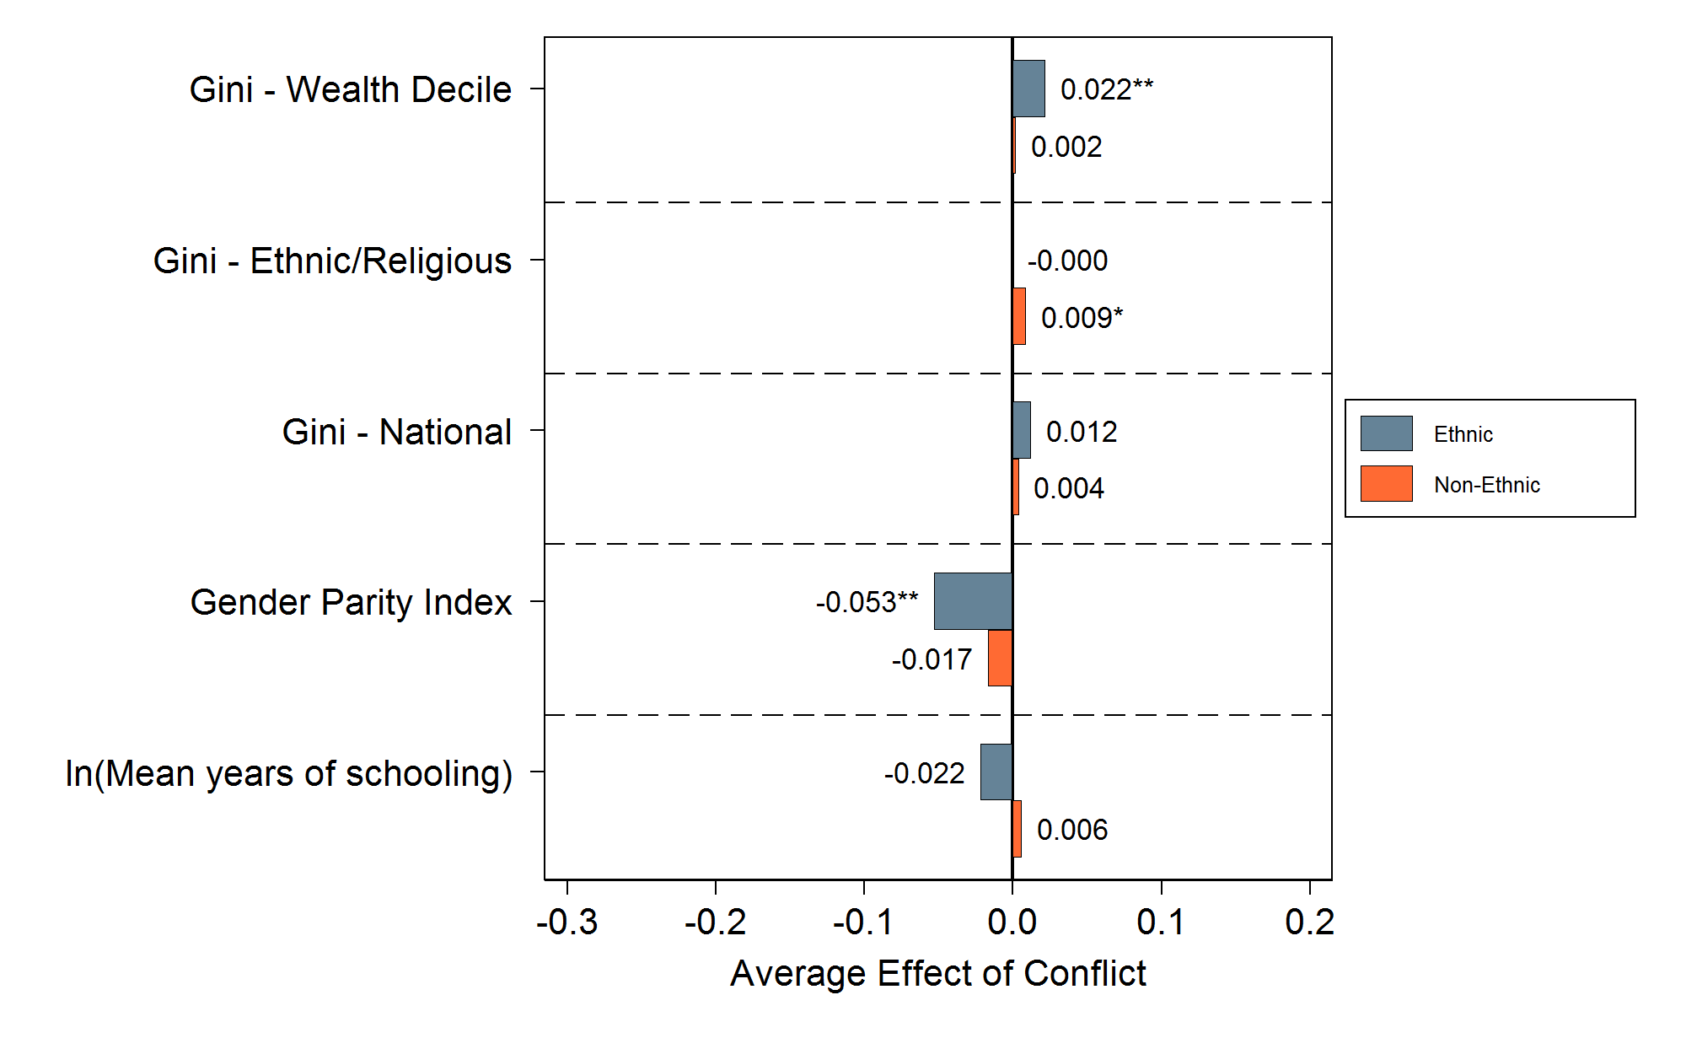
Ethnic conflict exacerbates inequality
Notes:
Across several measures of educational outcomes, ethnic conflicts have a larger impact than state (non-ethnic) conflicts. Ethnic conflicts lower mean years of schooling by 8.2 percent, while state conflicts lower mean attainment by 3.3 percent. In a similar pattern, ethnic conflicts increase wealth decile group education Gini, ethnic/religious group education Gini, and vertical education Gini by 3 points, 1 point, and 1.2 points, respectively, while state conflicts increase these educational inequalities by 1 point, 0.2 points, and 0.2 points, respectively.
These are average treatment effects.

Slide 32
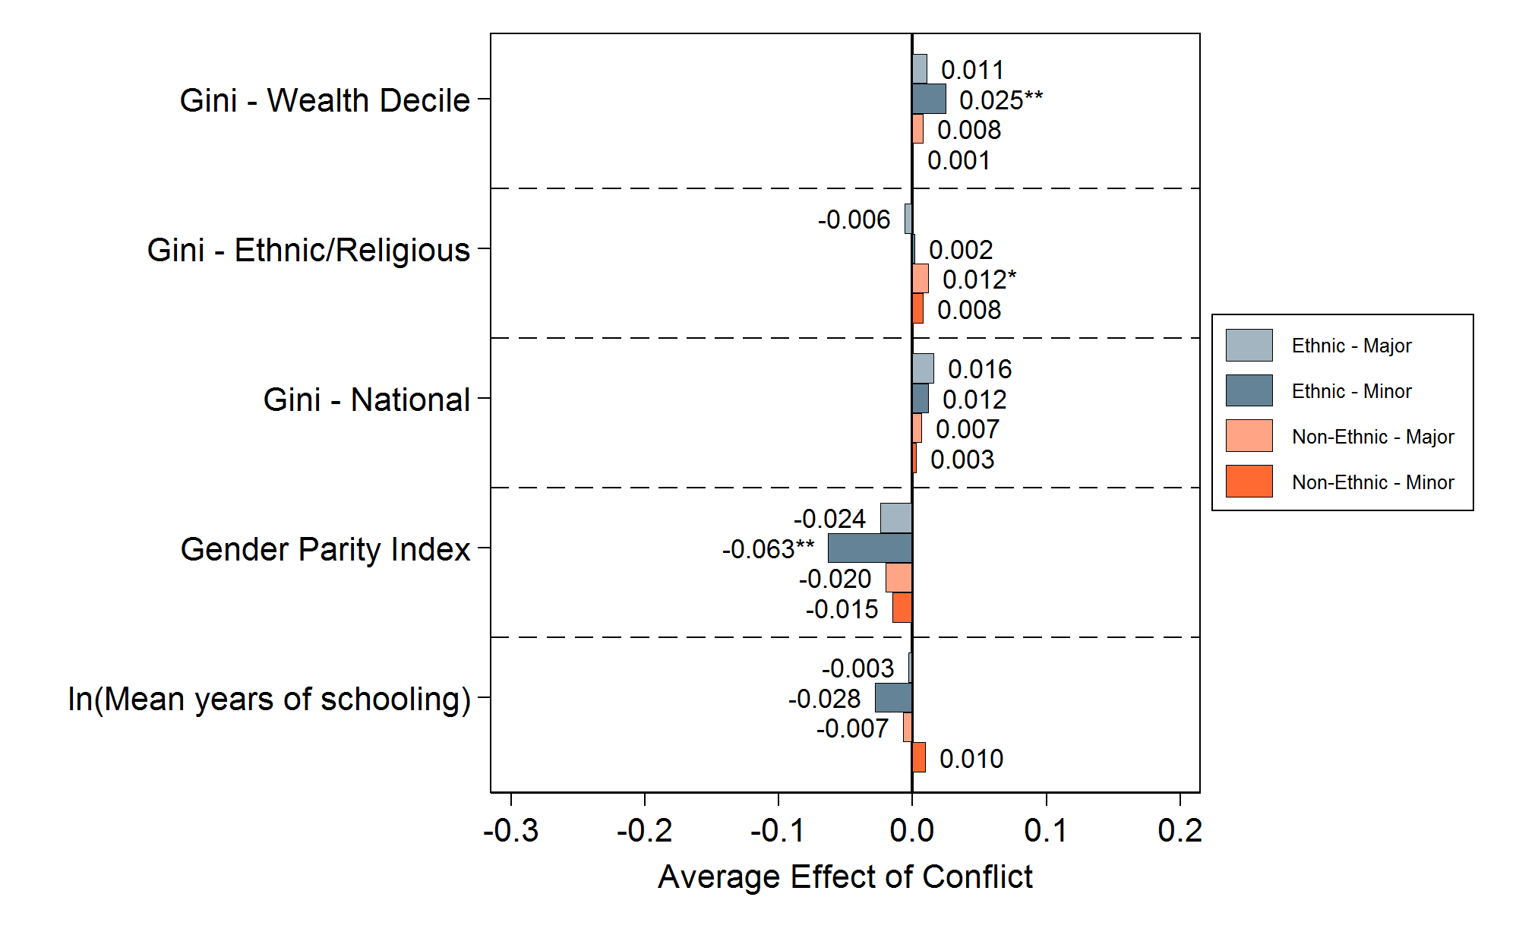
Effects of minor ethnic conflicts are most prominent
Notes:
This figure displays the estimated effect of conflict on educational outcomes over the duration of the conflict and stratified by type of conflict (state vs ethnic). The main conclusion from these figures is that ethnic conflicts are clearly influential in disrupting the education system and increasing educational inequalities. We know that ethnic conflicts have higher impact on inequality than non-ethic state conflicts. Additionally, we find that the impacts of ethnic conflicts are amplified over longer durations of conflict.
Average treatment effects

Slide 33
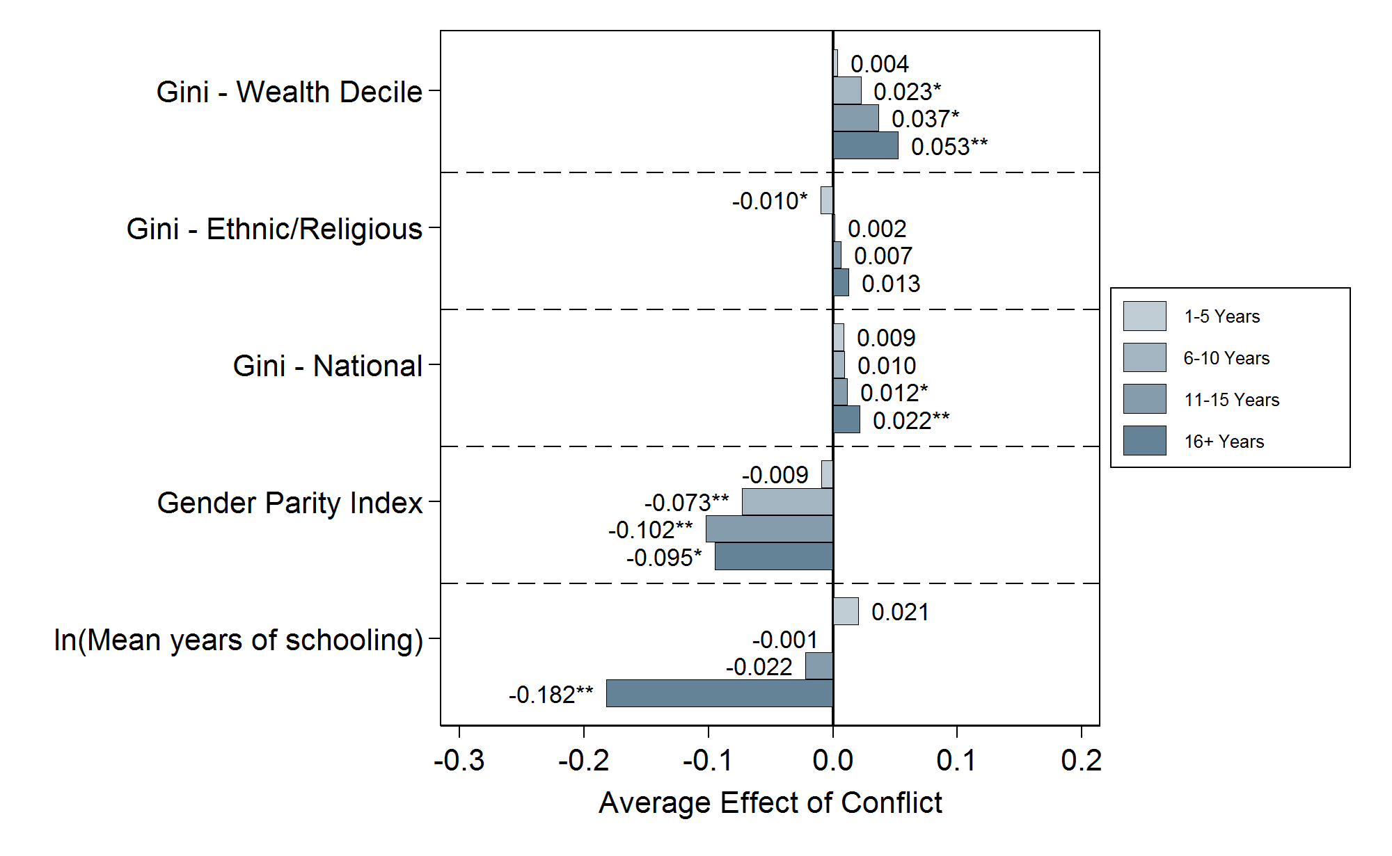
Effect of ethnic conflict increases with duration of conflict
Notes:
This figure displays the estimated effect of conflict on educational outcomes over the duration of the conflict and stratified by type of conflict (state vs ethnic). The main conclusion from these figures is that ethnic conflicts are clearly influential in disrupting the education system and increasing educational inequalities. We know that ethnic conflicts have higher impact on inequality than non-ethic state conflicts. Additionally, we find that the impacts of ethnic conflicts are amplified over longer durations of conflict.
Average treatment effects

Slide 34
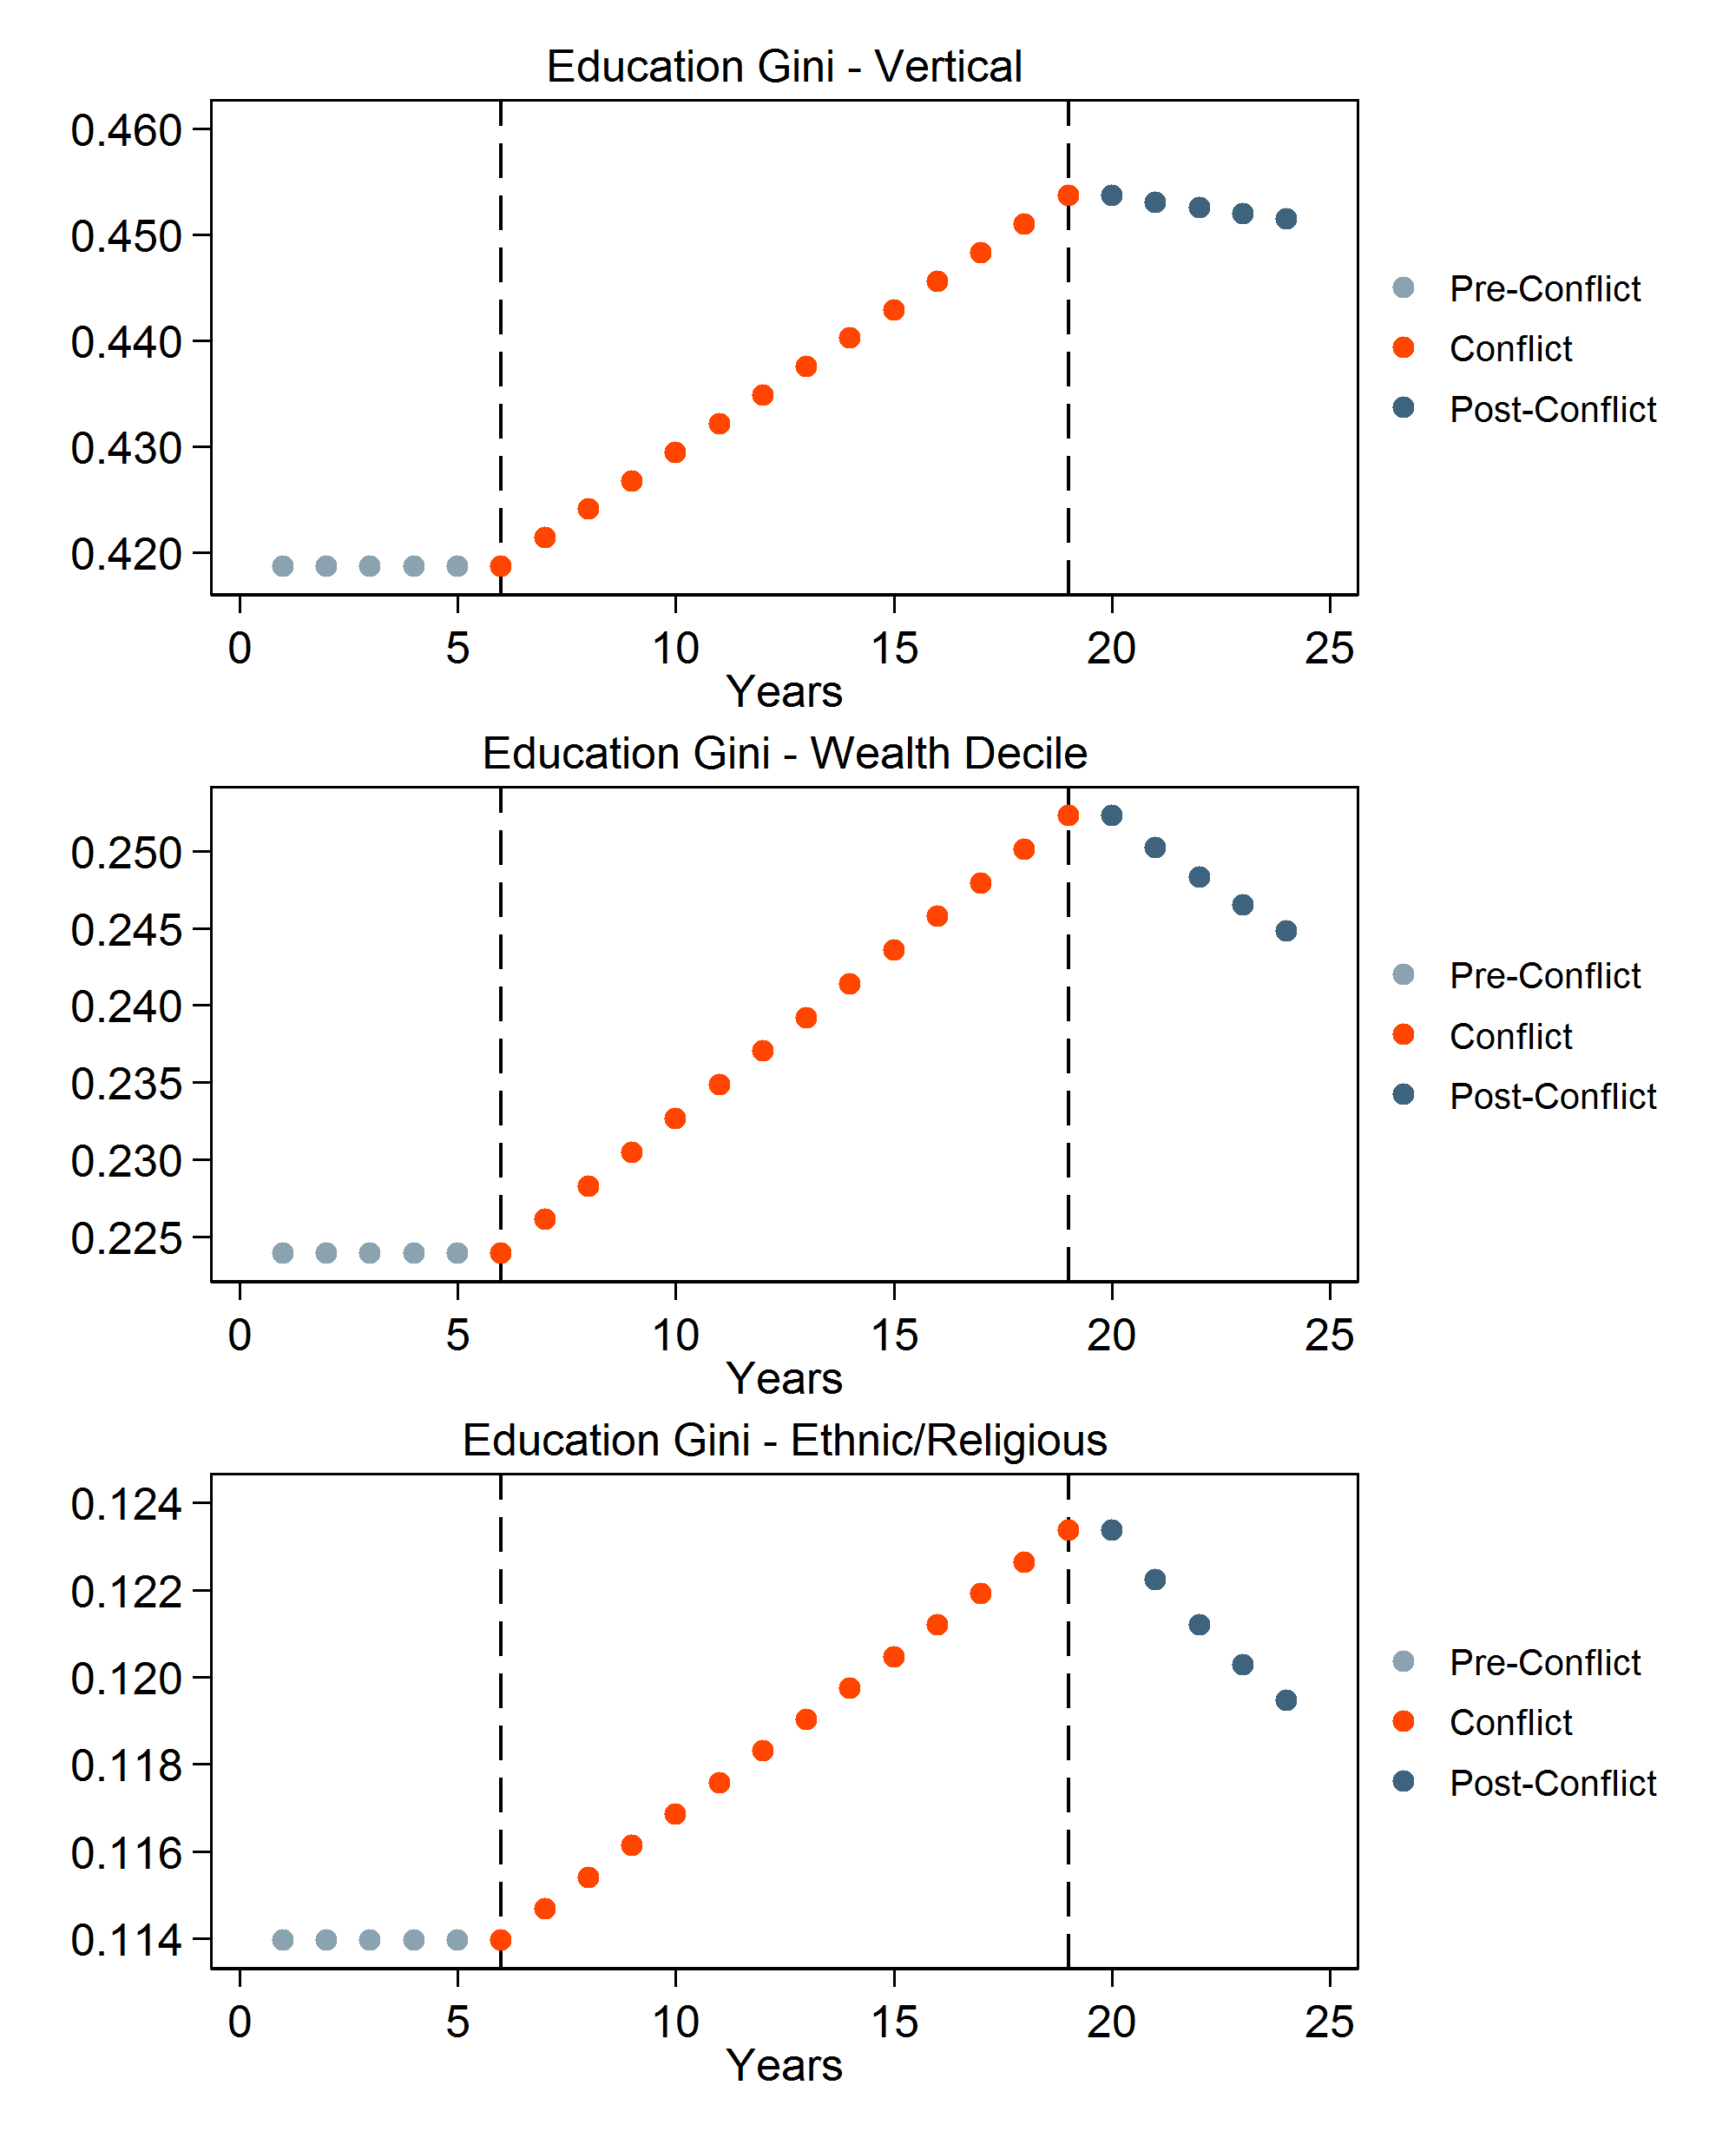
Inequality is lowered after the conclusion of ethnic conflict—but not immediate
We show that inequality worsens as conflict persists
This graph assumes a linear effect
Post-conflict inequality begins to revert back to its original levels
Depending on the duration of the conflict, original levels of inequality may never be recovered
Notes:
This figure displays the estimated effect of conflict on educational outcomes over the duration of the conflict and stratified by type of conflict (state vs ethnic). The main conclusion from these figures is that ethnic conflicts are clearly influential in disrupting the education system and increasing educational inequalities. We know that ethnic conflicts have higher impact on inequality than non-ethic state conflicts. Additionally, we find that the impacts of ethnic conflicts are amplified over longer durations of conflict.

Slide 35
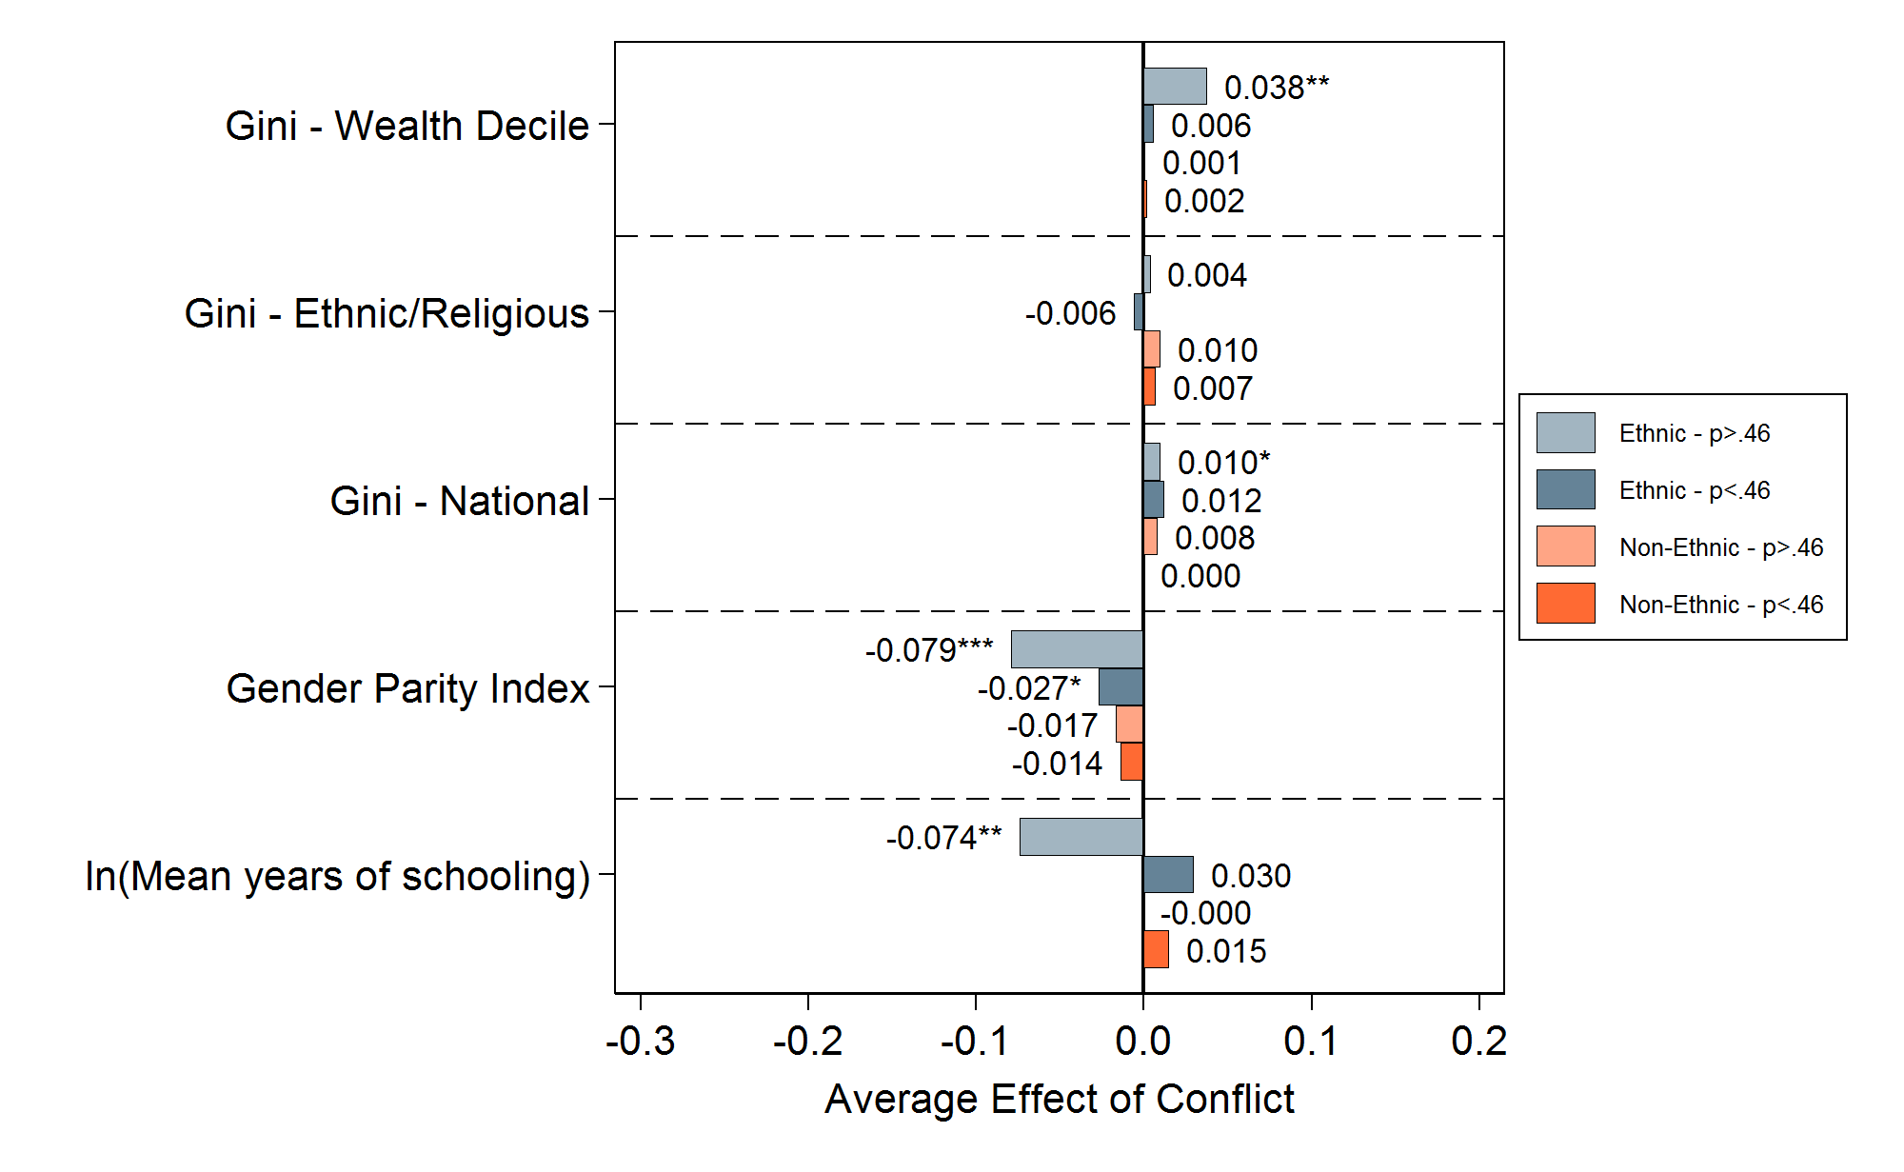
Effects ethnic conflict among most fragile are most detrimental
Notes:
This figure displays the estimated effect of conflict on educational outcomes over the duration of the conflict and stratified by type of conflict (state vs ethnic). The main conclusion from these figures is that ethnic conflicts are clearly influential in disrupting the education system and increasing educational inequalities. We know that ethnic conflicts have higher impact on inequality than non-ethic state conflicts. Additionally, we find that the impacts of ethnic conflicts are amplified over longer durations of conflict.
Average treatment effects

Slide 36
How substantial are these effects?
 | No Conflict |  | State Conflict |  | Ethnic Conflict
Vertical Education Gini | 0.42 |  | 0.41 |  | 0.48
 | (0.19) |  | (0.19) |  | (0.20)
Observations | 3,700 |  | 488 |  | 429
Wealth-based Education Gini | 0.22 |  | 0.23 |  | 0.25
 | (0.16) |  | (0.13) |  | (0.16)
Observations | 3,603 |  | 485 |  | 404
Ethnic/Religious Education Gini | 0.11 |  | 0.12 |  | 0.13
 | (0.09) |  | (0.08) |  | (0.09)
Observations | 3,398 |  | 411 |  | 412

Slide 37
Key Takeaways
Conflict does exacerbate inequality in education, both among groups and among individuals
This is true for countries that have experienced conflict (ATT); overall effects are less pronounced
Effects of ethnic conflict are most pronounced compared to non-ethnic state conflict
The longer the conflict, the higher the level of education inequality
Inequality post-conflict does improve, but may not return to pre-conflict levels for a while
Ethnic conflicts among fragile states are most detrimental to education
Notes:
Carina

Slide 38
Implications
A strong case for investment in education, both pre- and post-conflict
We need to understand inequality in resource allocation, quality and learning
Identify effective solutions to strengthen equity and mitigate disparities in education
Notes:
Too many words here – need to work on this slide!

Slide 39
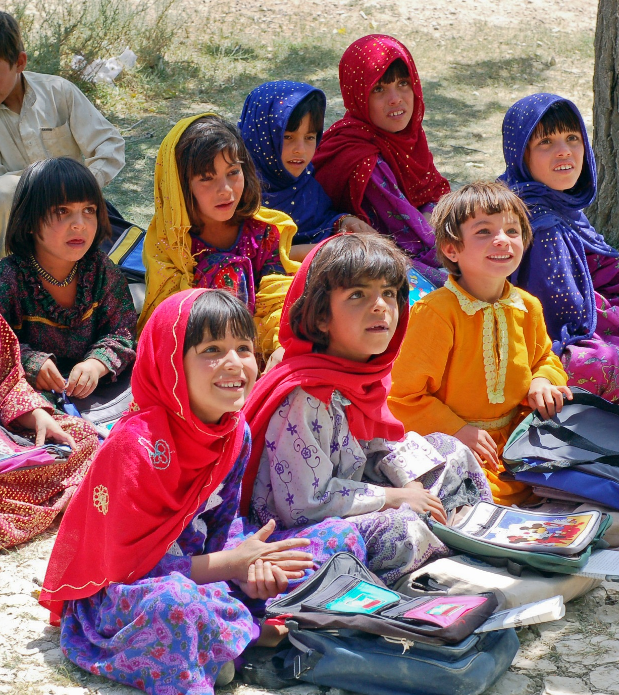
EDUCATION EQUITY RESEARCH INITIATIVE
A new research initiative led by FHI 360, Save the Children, UNICEF and other partners
Developing metrics the magnitude and effects of education inequality in programming and policy
Unpacking the root causes of inequality in outcomes
Building evidence on closing gaps and improving equity through education

Slide 40
About the study
Commissioned by UNICEF Peacebuilding, Education and Advocacy Programme (PBEA) as part of the Learning for Peace Initiative
Completed by FHI 360 Education Policy and Data Center
Carina Omoeva, Wael Moussa, and Rachel Hatch

Slide 41
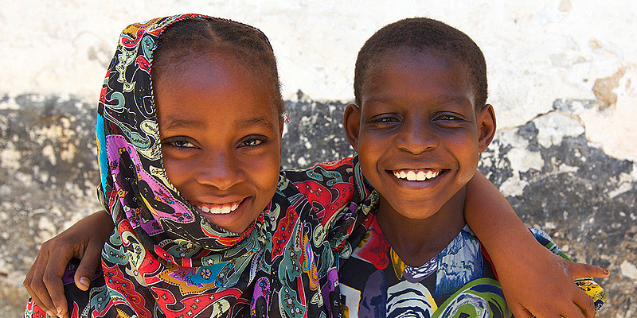
THANK YOU
Photo credit: Tanzania High Commission
Contact: comoeva@fhi360.org
wmoussa@fhi360.org

